Slide 1



Air Quality Monitoring in Bosnia and Herzegovina: Current Challenges and Future Prospects
Horizon Europe Project NextAIRE
HORIZON-WIDERA-2024-TALENTS-03-01
Prof. dr. Sabina Žero, University of Sarajevo – Faculty of Science
Prof. dr. Emina Ramić, University of Sarajevo – Faculty of Pharmacy
Sarajevo Summer School,
7 - 9 September 2026, Sarajevo, Bosnia and Herzegovina

Slide 2


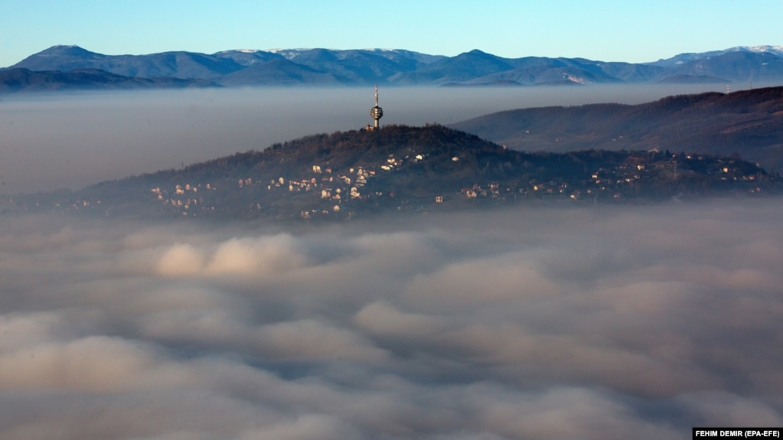
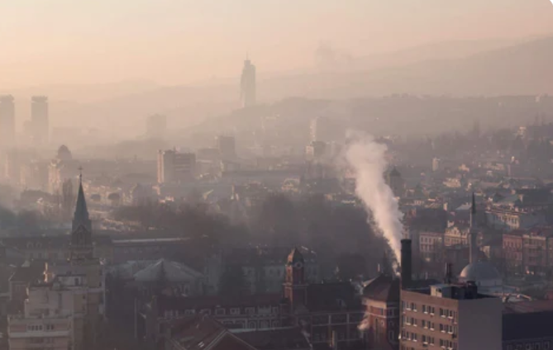

Why the air of Sarajevo and Bosnia and Herzegovina?
1Squeezed into a steep valley in the mountains, Sarajevo recorded an Air Quality Index (AQI) of 301, which is considered Very Unhealthy, making it the most polluted city in the world on December 19. The Indian city of Kolkata was indexed at 239.

Slide 3
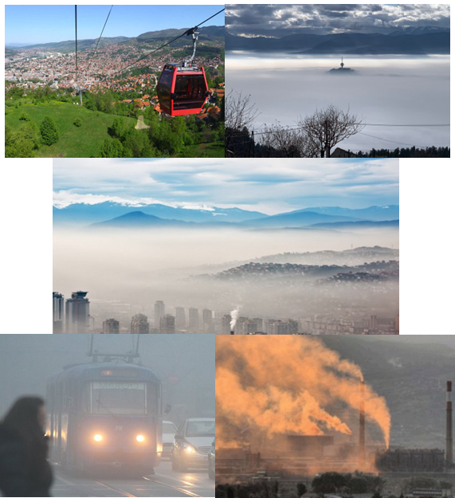
How clean is the air we breathe?
2012. - 230.6 deaths/100,000 people;
Sarajevo is one of the most polluted;
9% country's deaths are due to air pollution.
3,300 people die prematurely
19 - Automatic air quality monitoring
stations 2017;
Figure 1. Winter in Sarajevo and Bosnia and Herzegovina

Slide 4
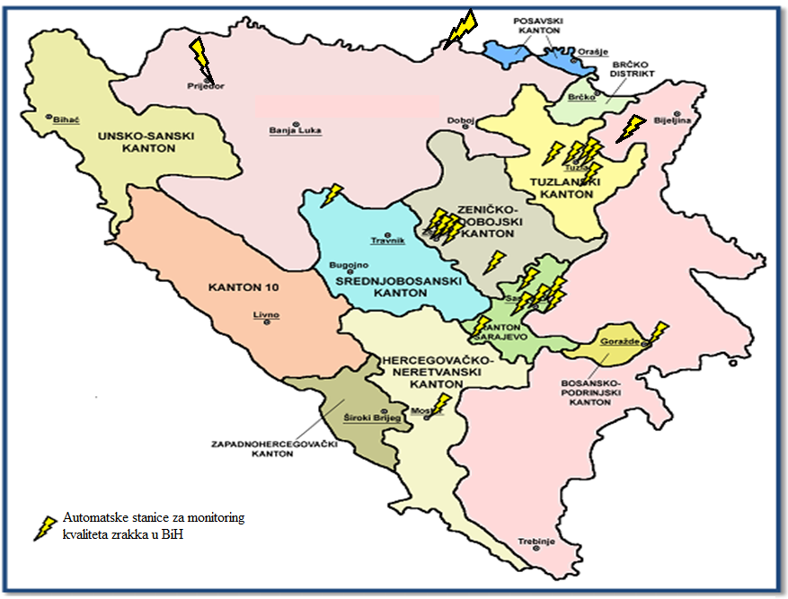
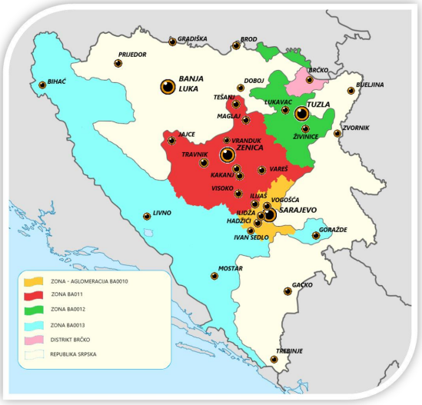
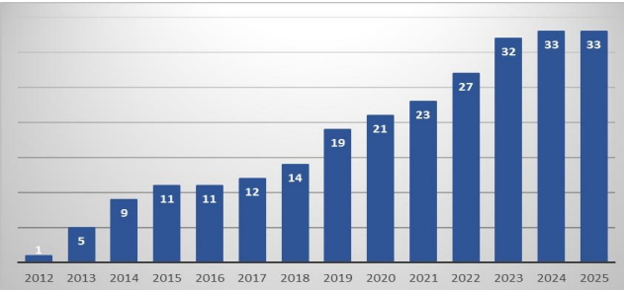
2020. December
2025 December
Figure 1. Number of air quality monitoring stations in Bosnia and Herzegovina

Slide 5
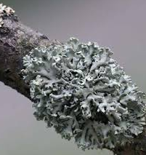
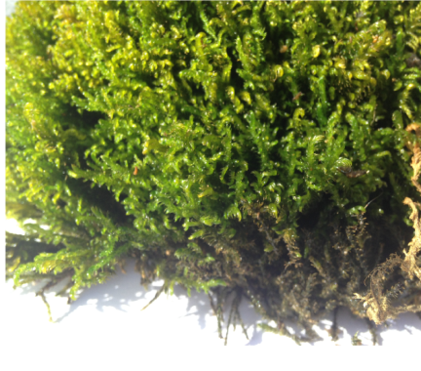
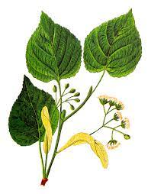
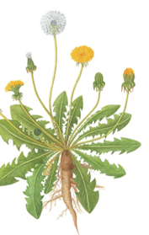
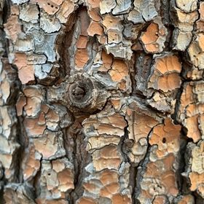
Is there an alternative?
Alternatively, biological monitors (biomonitors and bioindicators) can be used to characterize small-scale gradients of air pollution.
Biomonitoring refers to using living organisms as monitors to assess environmental pollutants in the ecosystem.
Mosses lack proper roots and absorb all their nourishment like sponges through their leaves, which makes them particularly good at feeding on pollutants and fine particles of dust in the air.
Lichen species, symbiotic organisms of fungi and algae or cyanobacteria, are excellent air pollution markers
Hypogymnia physodes (Lichen)
Hypnum cupressiforme (Moss)
Their large, heart-shaped leaves have dense hairs and waxy cuticles that effectively trap heavy metals (like Pb, Cu, Ni) and airborne particulate matter, reflecting local traffic and industrial emissions
Tree bark is exposed to airborne contaminants over many years and accumulates these substances in the outer bark layers
Tilia spp. (Lime tree)
Taraxacum officinale (Dandelion)

Slide 6
Biomonitoring, bioindicator and biomonitor
Biomonitoring refers to using living organisms as monitors to assess environmental pollutants in the ecosystem.
Bioindicators qualitatively assess biotic responses to environmental stress
Bioindicators actually indicate the general toxicity of the environment, without telling the exact quantity of the toxicity.
Biomonitors are an organism (or part of an organism) used to quantitatively determine environmental quality or the concentration and biological impact of pollutants over time.

Slide 7
Characteristics of Biomonitors and Bioindicators
1. Sensitivity to Pollutants
Bioindicators (e.g., lichens, mosses) must exhibit clear physiological, biochemical, or morphological changes in response to the presence of pollutants (e.g., SO₂, heavy metals, ozone). Some species are highly sensitive,
while others are more tolerant this allows classification of pollution levels.
2. Wide Distribution and Immobility
They must be available in different regions and remain in a fixed location, which enables spatial analysis of
pollution. Mosses and lichens grow slowly and stay attached to their substrate.
3. Long Lifespan
This allows for the long-term accumulation of pollutants and the analysis of changes over time.
4. Accumulation Ability
They can absorb and accumulate airborne pollutants (e.g., heavy metals, other pollutants) without direct contact with liquid or solid sources, as they lack roots. Mosses and lichens absorb all necessary substances
directly from air and precipitation.
5. Quantifiability of Effects
Changes in community composition (e.g., species number, coverage) or tissue chemical composition can be measured and used for pollution mapping.

Slide 8
6. Ecological Relevance
They reflect actual biological responses to pollution, in contrast to purely technical measurements of pollutant concentrations.
7. Low Nutrient Requirements
Many bioindicators (especially lichens and mosses) can survive in nutrient-poor environments, making them ideal for urban and industrial monitoring.
8. No Root System
Bioindicators like mosses and lichens absorb substances directly from the atmosphere, not from the soil,
ensuring that measured pollutants reflect air quality.
9. Cost-Effective and Low-Maintenance available year-round
Compared to instrumental methods, biological monitoring is affordable and requires minimal equipment
and maintenance.
10. Easy Sampling and Identification
Species can be collected and identified relatively easily, even in field conditions.
11. Demonstrate correlation with pollution levels
12. Show high concentration factors

Slide 9
Table 1. Comparison of physical automatic stations and biological monitoring methods
Characteristic | Physical Automatic Stations | Biological Monitoring
Economic Cost | Very high equipment, calibration, and power costs. | Extremely low cost; requires no electrical grid.
Spatial Grid Density | Sparse. Fixed to highly specific urban centers. | Virtually infinite. Can deploy hundreds of points.
Data Profiles | Immediate, transient concentrations of gases. | Long-term cumulative history of heavy metals.
Biological Relevance | Measures concentration, not tissue impact. | Directly reflects toxicological stress on living cells.

Slide 10
Biomonitoring
Passive
Changes in community composition
Active
Transplantation
Species presence
Absence of the species
In situ biomonitoring
Heavy metals content
Gaseous pollutants
(NO_{x} and SO_{x})
Direct transplantation
Perforated bags with lichens or mosses
Gaseous pollutants
(NO_{x} and SO_{x})
Heavy metals content
Gaseous pollutants
(NO_{x} and SO_{x})
Heavy metals content
Figure 2. Biomonitoring methods of pollutants using lichens and mosses (Vitarana, 2013)

Slide 11
Current Challenges in BiH
Lack of Continuity
  - Instrumental monitoring is often not possible because technical failures or insufficient funding for station maintenance.
Complex Sources of Pollution
  - It is difficult to precisely differentiate the impact of industry, traffic, and massive private residential heating on solid fuels during winter.
Lack of Integration
  - Biomonitoring in BiH is mainly conducted through isolated academic and scientific research
  - It is still not officially integrated into state environmental legal frameworks and public health networks

Slide 12
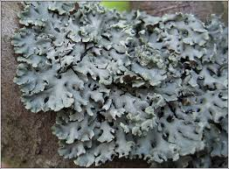
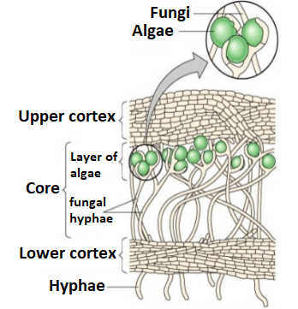
Hypogymnia physodes
Lichens are symbiotic associations of fungi and algae or cyanobacteria
Fungi make up the largest part of lichen biomass.
Algae, thanks to their symbiosis with fungi, get mineral substances from them, as well as the possibility of inhabiting habitats whose conditions are unfavorable for the life of the algae itself.
Hypogymnia physodes is a common species, widespread in Europe but also in North America, East Africa and the Himalayas.
The upper surface of its thallus is smooth, grey or grey–green with brownish lobe ends.
H. physodes is sampled mainly on the bark of coniferous and deciduous trees. This acidophytic species prefers substrates with a lower pH, e.g. pine, birch, spruce, beech, oak, and alder.
The analysis of whole-lichen samples is practical, sensitive and is relatively cost effective.
Figure 3. Hypogymnia physodes(L.) Nyl.

Slide 13
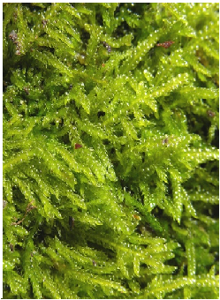
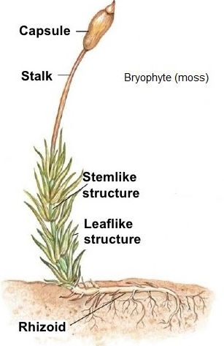
Hypnum cupressiforme
Since the late 1960's mosses have been used as bioindicators for metal deposition.
The lack of any root system and water-conducting tissue,
The inability to react to pollution by dropping leaf,
Widespread occurrence qualify mosses to accumulate airborne metals and to reflect their spatial and temporal variation.
Epiphytic mosses have ability to resist periods of drought and to revive immediately during misty, rainy periods, they survive even at extremely dry sites.
Mosses take up nutrients and pollutants from the atmosphere and precipitation through their leaves
They have a poorly developed cuticle that makes their cell walls easily accessible to metal ions, they also have a high surface area to mass ratio, and they also have pronounced ion exchange properties.
Hypnum cupressiforme is one of the mosse growing on tree trunks
Hypnum cupressiforme spreads all over Bosnia and Herzegovina and is easy to identify.
Figure 4. Hypnum cupressiforme

Slide 14
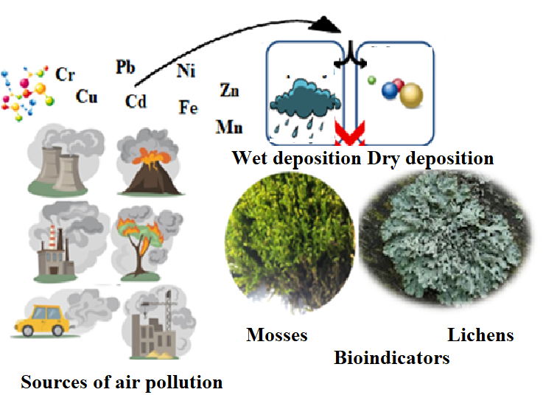
How lichens and mosses can help us in monitoring the level of air pollution?
Major sources of pollutant emissions:
In Sarajevo are residential heating, traffic and some point sources such as industrial plants.
Tuzla and Kakanj, thermal power plan
Zenica, steel plant
Bosnia and Herzegovina produces electricity by burning lignite, a low-quality polluting type of coal found in abundance throughout the country, in outdated coal plants.
Poor building insulation and using coal, wood, and other plant materials for heating contributes to pollution.
burning of fossil fuels for transportation, heating fuel, waste burning, electricity generation, and other industrial activities

Slide 15
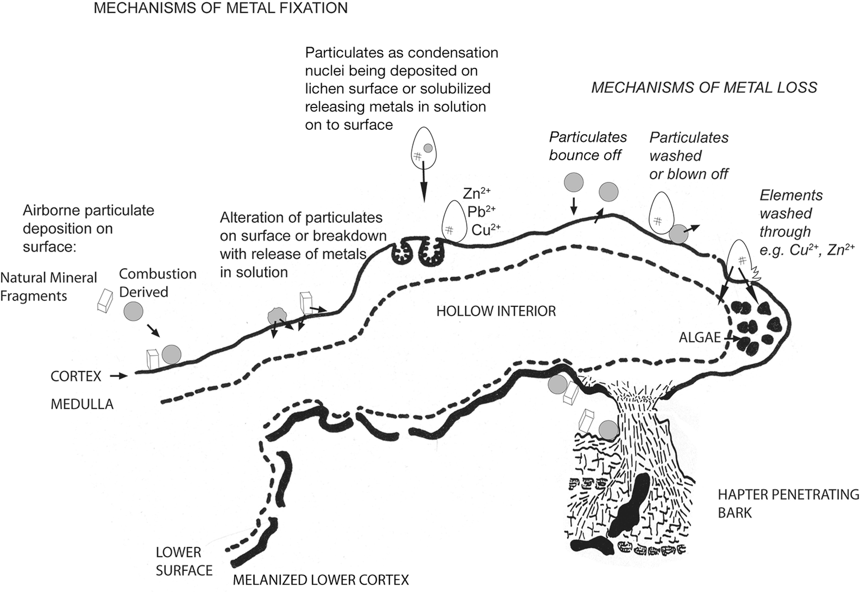
Figure 5. Schematic representation of metal deposition and loss mechanisms on lichen Hypogymnia physodes

Slide 16
Objectives of our studys:
Air Quality Assessment in Bosnia and Herzegovina
Determining the content of heavy metals (Cd, Cr, Cu, Fe, Mn, Ni, Pb, and Zn) in epiphytic lichens and mosses across Bosnia and Herzegovina.
Temporal Indoor and Outdoor Pollution Monitoring
Tracking metal accumulation in transplanted lichens/moss at 3, 6, 9, and 12-month intervals at the different locations in Sarajevo city
Environmental Risk Evaluation
Assessing whether lichens act as secondary sources of pollutants by releasing accumulated metals back into the environment.

Slide 17
How we use biomonitoring
Biological Indicators (Lichens & Mosses)
  Passive Biomonitoring: Collecting native, naturally growing samples to assess long-term, regional air pollution.
  Active Biomonitoring: Using the transplant method (deploying samples to specific indoor/outdoor locations) to track pollution over controlled time intervals.
Metal Content Analysis
  Conducting the primary analysis and monitoring of heavy metal concentrations in the collected and transplanted samples.
Acid Rain Simulation
  Simulating acid rain under laboratory conditions to monitor metal desorption (the release of accumulated metals from the lichens).
Surface & Particle Analysis (SEM/EDS)
  Identifying morphological changes on the lichen surface caused by pollution.
  Determining the origin of the particles based on the chemical analysis of particulate matter deposited on the surface.

Slide 18
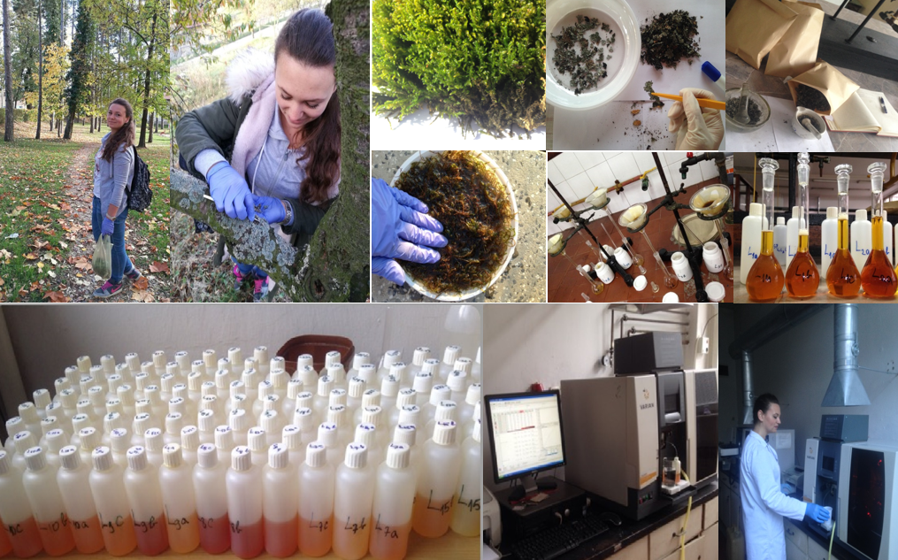
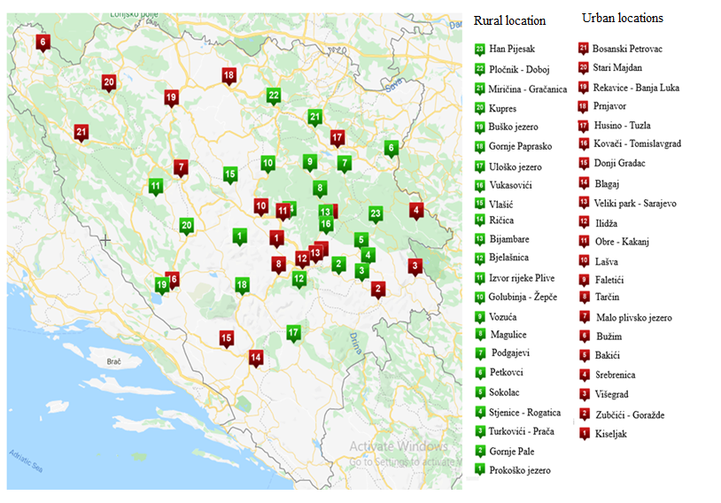
Figure 6. Sampling, sample preparation, metal analysis
Figure 7. Mosses and lichens sampling locations
Lichen Hypogymnia physodes and moss (Hypnum cupressiforme) samples were collected at 44 locations in Bosnia and Herzegovina
- 21 samples from urban locations;
- 23 samples from rural locations;

Slide 19
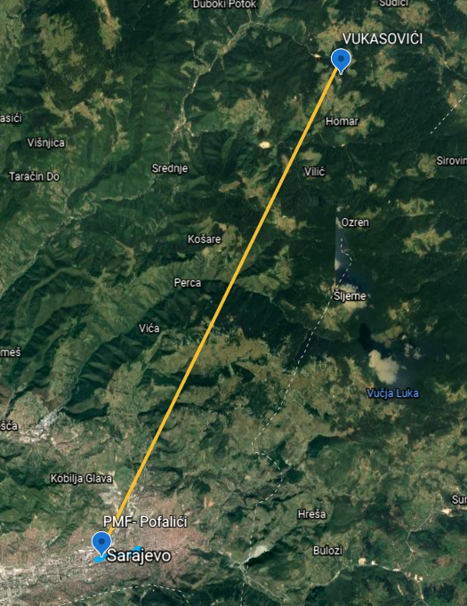
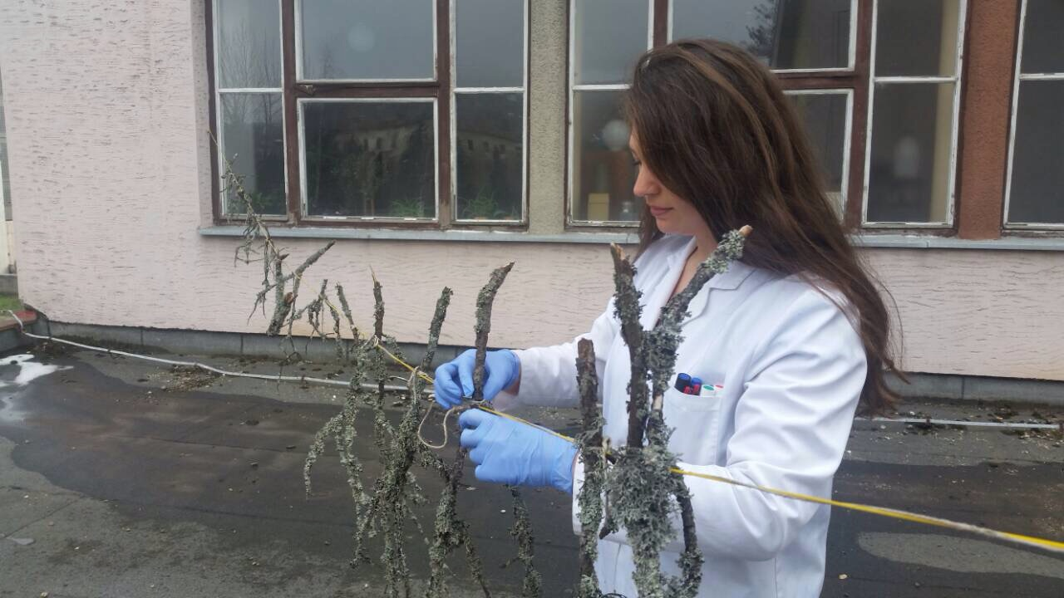
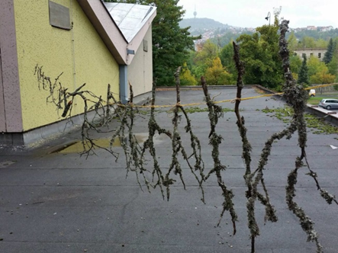
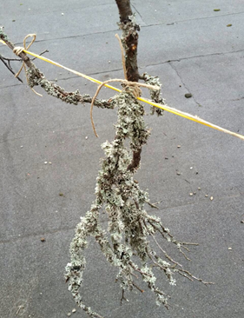
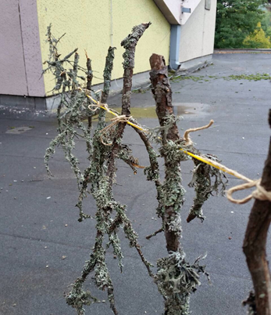
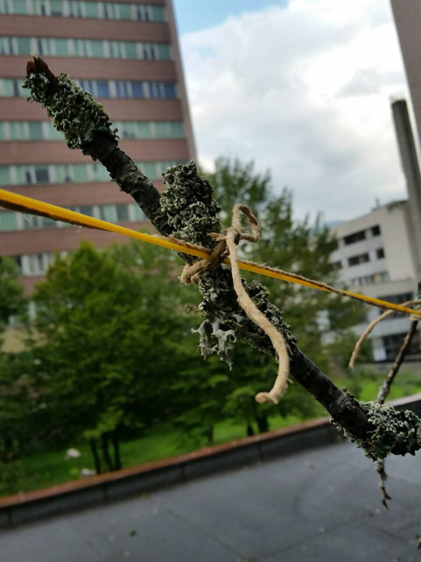
Transplantation of Hypogymnia physodes lichen samples
Collection Site: Anpolluted area (e.g. Vuksovići (Ilijaš), 1100 m.a.s.l., 7.1 km from main road M18, non-industrial area.
Date of Collection: 24th September 2017-15th October 2026
Transplantation Site: Rooftop of Faculty of Natural Science, Pofalići (branches fixed with rope), home, office, faculty, schools
Exposure Durations:
3 months
6 months
9 months
12 months

Slide 20
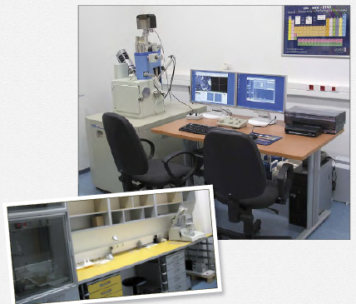
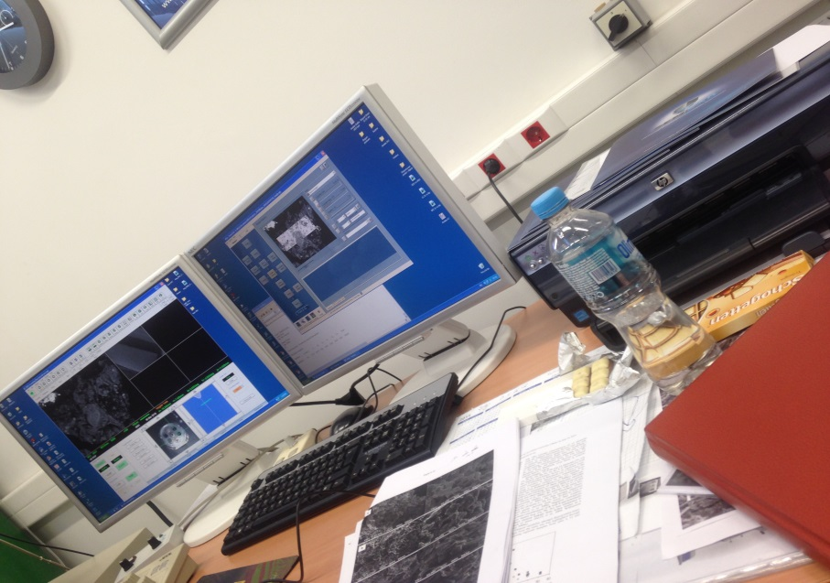
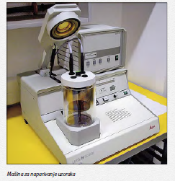
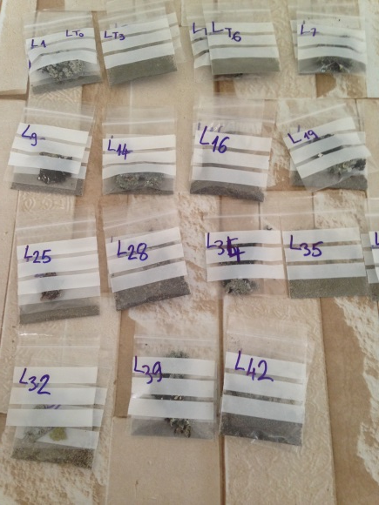
Scanning Electron Microscopy with Energy-Dispersive X-ray Spectroscopy (SEM-EDS)
Scanning Electron Microscopy (SEM) is a technique that uses a focused beam of electrons to create high-resolution images of the surface of a sample. It provides detailed topographical and morphological information at the micro- and nano-scale.
Energy-Dispersive X-ray Spectroscopy (EDS) is often used alongside SEM to identify and quantify the elemental composition of the sample. When the electron beam hits the sample, it causes the atoms to emit characteristic X-rays. EDS detects these X-rays and determines which elements are present.

Slide 21
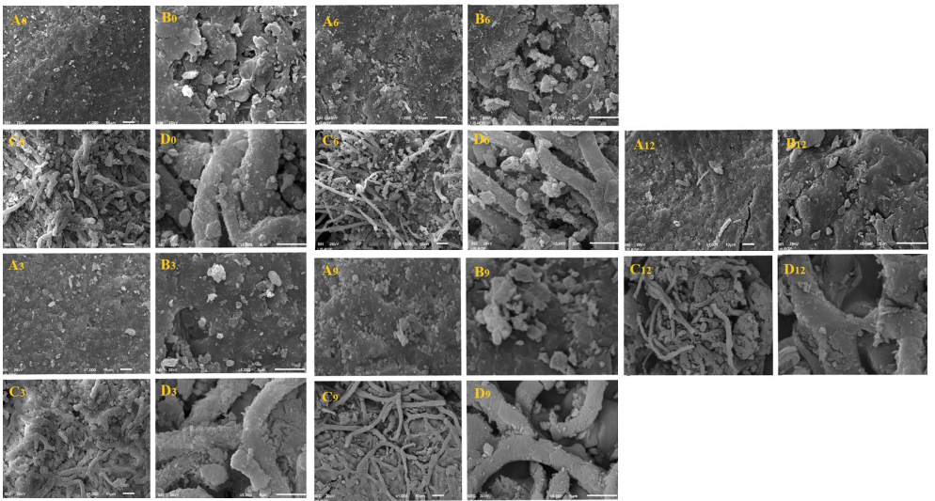
Figure 8. Scanning electron micrographs of lichen Hypogymnia physodes. Surface of the lichen: A (×1000) and B (×5000), surface of the hyphae: C (×1000) and D (×5000); 0 – control sample and 3 month (right), 6 and 9 month exposed samples (central) and 12 month exposed samples (right)

Slide 22
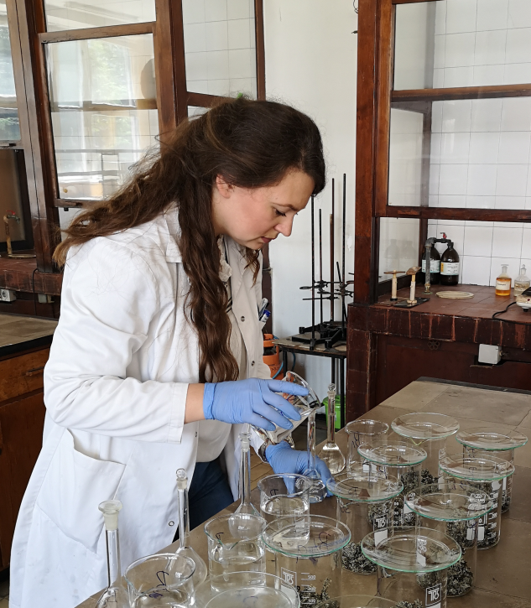
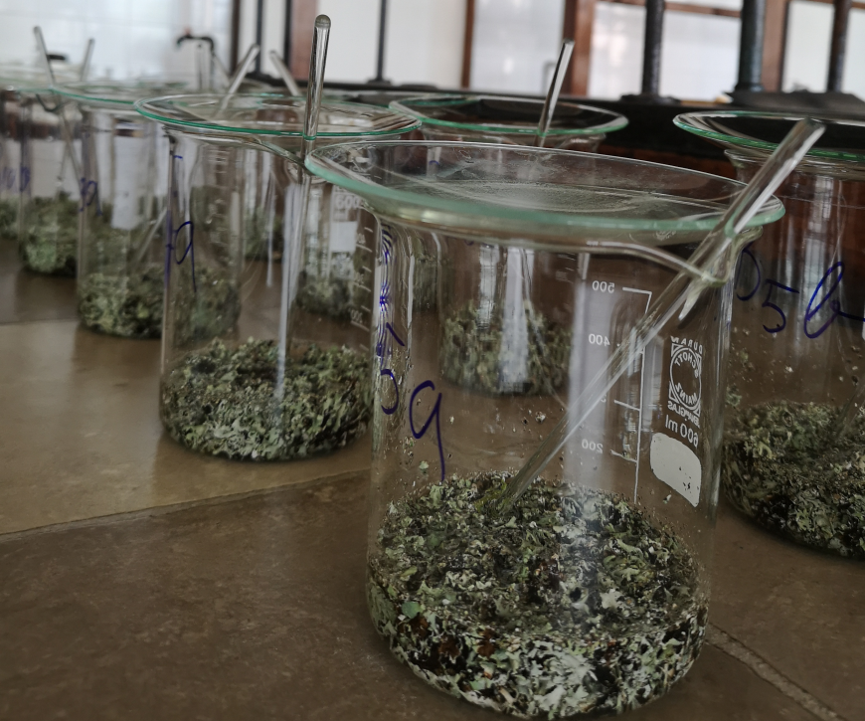
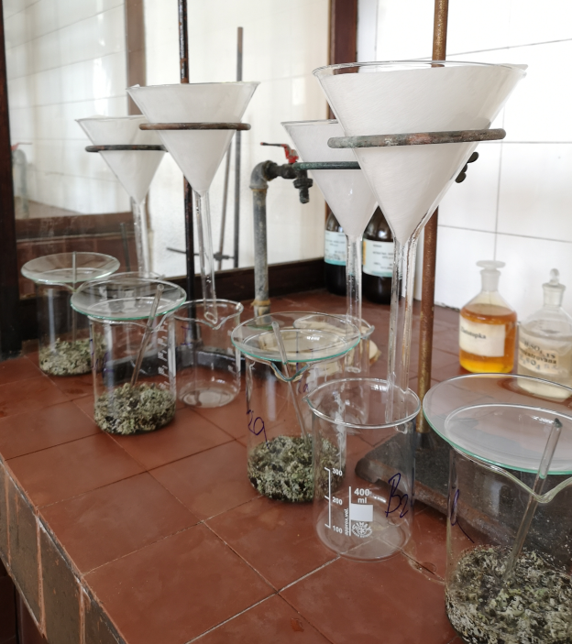
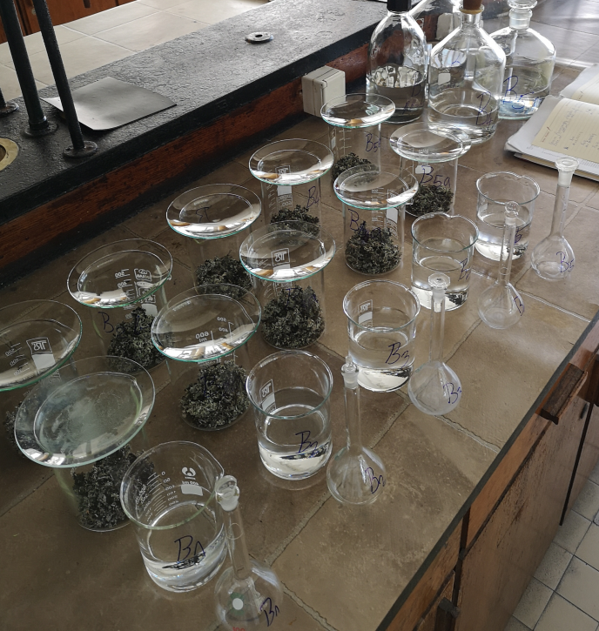
Acid Rain Simulation and Desorption of Heavy Metals from Lichens
Sample Preparation: Lichen samples were homogenized and placed in contact with acid solution H₂SO₄-HNO₃-(NH₄)₂SO₄-NH₄NO₃. (pH ≈ 2,02; 2,55; 3,61; 4,33 i 5,12) to mimic acid rain conditions.
Procedure:
Lichens were soaked in the acid solution for a 24 h, with occasional stirring of the solution.
After exposure, the solution were filtered and analyzed.
Analysis Method: Desorbed metal concentrations were determined using Flame Atomic Absorption Spectroscopy (FAAS).

Slide 23
Results of Acid Rain Simulation and Desorption of Heavy Metals from Lichens
No extraction | pH | Percentage of desorbed metals after each extraction, %
Metals |  | Cd | Cr | Cu | Fe | Mn | Ni | Pb | Zn
I Extraction | 2,02 | 17,59 | * | 13,72 | 7,69 | 65,33 | 6,19 | 7,17 | 53,82
 | 2,55 | 11,52 | 62,56 | 10,81 | 2,39 | 53,61 | 4,50 | 0,60 | 2,08
 | 3,61 | 11,22 | * | 6,89 | 1,42 | 54,21 | 5,84 | * | 29,84
 | 4,33 | 19,41 | 6,21 | 8,59 | 1,83 | 50,59 | 7,94 | 1,72 | 4,94
 | 5,12 | 17,59 | * | 9,76 | 1,77 | 48,45 | 6,98 | * | 25,60
II Extraction | 2,02 | 30,33 | * | 24,39 | 12,18 | 16,00 | 10,09 | 9,23 | 29,12
 | 2,55 | 15,47 | 1,65 | 10,15 | 1,68 | 15,86 | 7,45 | 1,86 | *
 | 3,61 | 9,71 | 1,31 | 7,83 | 0,89 | 15,77 | 7,11 | * | 12,53
 | 4,33 | 16,98 | 0,22 | 8,92 | 1,10 | 17,10 | 5,48 | 5,38 | *
 | 5,12 | 18,80 | 1,98 | 7,17 | 0,99 | 18,36 | 4,18 | * | 16,43
III extraction | 2,02 | 11,83 | * | 23,47 | 10,45 | 6,98 | 7,24 | 12,38 | 14,58
 | 2,55 | 10,92 | * | 7,94 | 2,54 | 6,87 | 6,31 | 0,98 | 1,43
 | 3,61 | 10,01 | * | 6,92 | 0,70 | 7,35 | 6,65 | * | 11,33
 | 4,33 | 5,16 | * | 6,29 | 0,76 | 8,97 | 8,27 | 1,43 | 1,11
 | 5,12 | 3,34 | * | 5,36 | 0,63 | 9,03 | 5,73 | * | 15,37
The total extracted after all extractions, %
 | 2,02 | 60 | * | 62 | 30 | 88 | 24 | 29 | 98
 | 2,55 | 38 | 64 | 29 | 7 | 76 | 18 | 3 | 4
 | 3,61 | 31 | 1 | 22 | 3 | 77 | 20 | * | 54
 | 4,33 | 42 | 6 | 24 | 4 | 77 | 22 | 9 | 6
 | 5,12 | 40 | 2 | 22 | 3 | 76 | 17 | * | 57

Slide 24
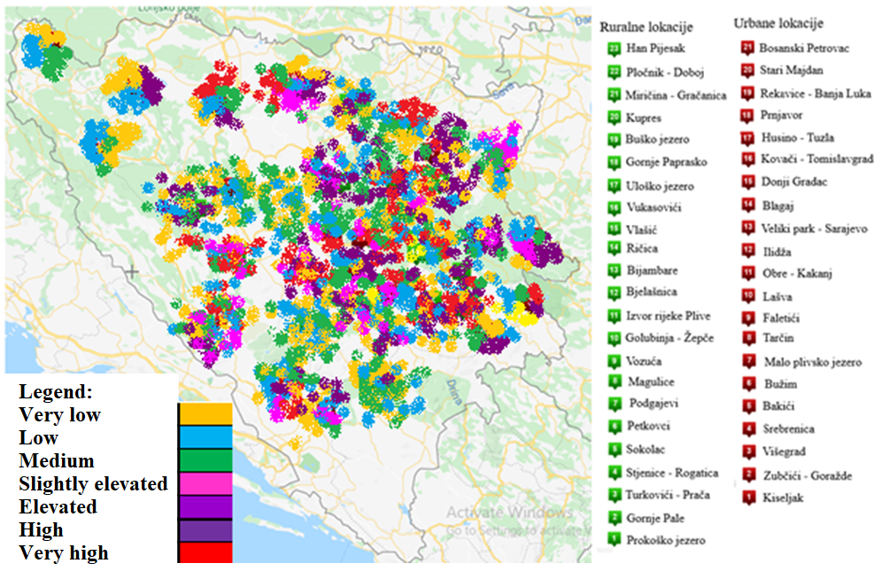
Figure 9. Overview of air pollution levels in BiH based on metal content in lichen and moss (2017)

Slide 25
Future Prospects
Systemic Integration
  -Integrating biomonitoring as a complementary method to official monitoring stations.
  -A cost-effective approach that allows wider geographic coverage, including rural areas lacking expensive equipment.
Standardization (EU Norms)
  -Aligning methodologies with European standards.
  - Ensuring that data collected in BiH is fully comparable with the rest of Europe.
Adoption of Modern Techniques
  -Combining chemical analysis of lichen tissue with Geographic Information Systems (GIS).
  -Utilizing advanced emission registers to create precise, real-time pollution maps.

Slide 26
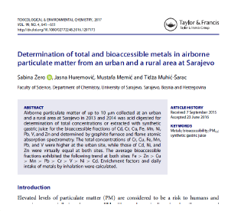
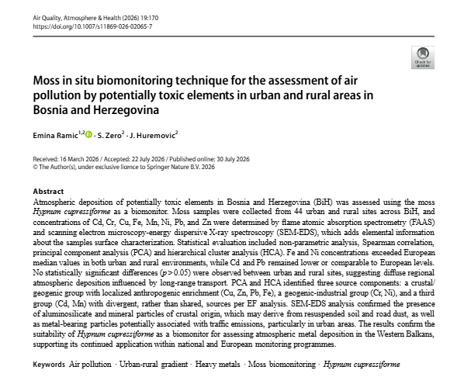
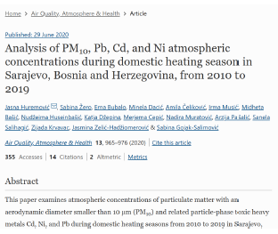
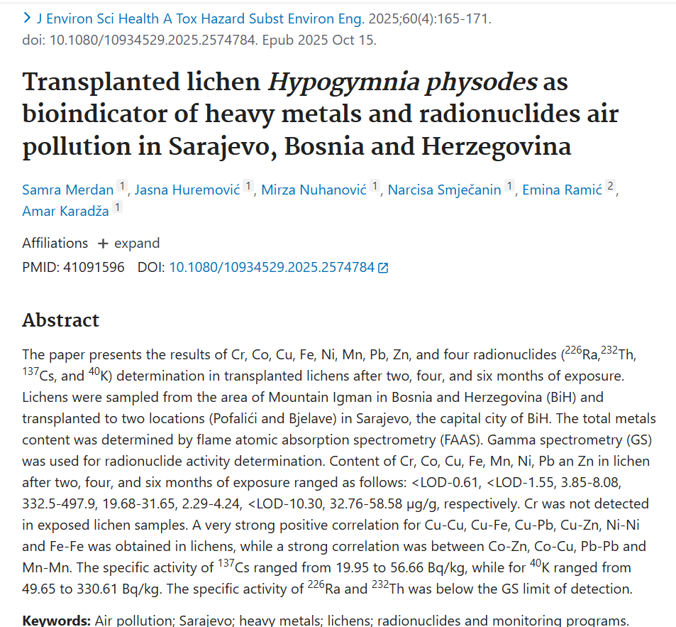


Slide 27
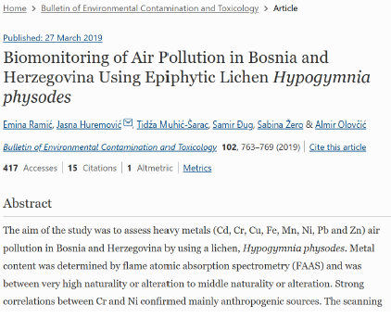

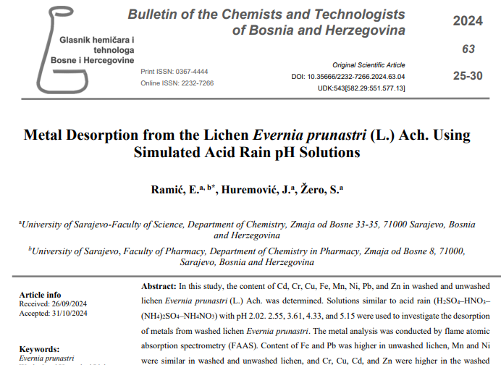

Slide 28
Thank you!

